Slide 1

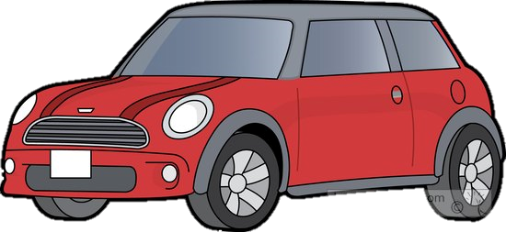
Vehicle Intersection control
Alex Jackson
Jean Lucas Ferreira
Justin Kapinski
Mathew Hobers
Radhika Sharma
Zachary Bazen
Group 6
VIC -1
Intersection Management for autonomous
vehicles

Slide 2
OUTLINE

Slide 3
THE PROBLEM
How should autonomous vehicles behave when approaching a four-way stop?
single vehicle scenario
multiple vehicles scenario
Notes:
The problem : what to do when more than one vehicle arrives at the intersection at one time
smart intersections to improve efficiency at stop sign intersections
Our Goal ( to increase efficiency of autonomous vehicles at stop sign intersections)

Slide 4
THE SOLUTION
Smart Intersection
Single Vehicle Scenario Solution
Multiple Vehicle Scenario Solution
Decreases time vehicles spend at intersection
Cars save fuel
Cars don’t necessarily have to stop
Two Components:
Intersection Controller
Vehicle Controller
Notes:
Slide for explaining overall system

Slide 5
INTERSECTION CONTROLLER
What does it do?
Monitors intersection
Manages traffic flow
How does it work?
Vehicle requests to proceed
Controller grants request when appropriate
Notes:
WHY WE CHOSE TO DO IT THIS WAY
What it does
manages traffic flow
A camera and Computer
chose this approach because the track is shared and we did not want to interfere with other groups, ideally other types of sensors would be used
How it works

Slide 6
VEHICLE CONTROLLER
What does it do?
- Controls motion and direction of vehicle
- Ensures vehicle follows lanes and avoids obstacles
How does it work?
- Keeps vehicle in the lane
- Communicates to the intersection controller when needed
Notes:
WHY WE CHOSE TO DO IT THIS WAY

Slide 7
DESIGN DECISIONS
Intersection Infrastructure VS V2V
Wireless communication is less reliable for multiple moving vehicles
Multiple systems to interpret information
Notes:
Intersection Infrastructure VS V2V
Wireless communication is less reliable for moving vehicles - Doppler Effect
Multiple systems to interpret information - robustness

Slide 8
INNOVATIVE ASPECTS
Notes:
FOR FUTURE USE: (is capable of detecting non autonomous vehicles and pedestrians & Smart Traffic)

Slide 9
1
1
Request
Intersection Controller
3
1
2
Proceed
2
2
3
3

Slide 10
COST
PART | QUANTITY | PRICE ($) | TOTAL ($)
RC Car (w/ servo & speed controller) | 2 | 240 | 480
3300 mAh 7.2 V battery | 2 | 30 | 60
Battery charger | 1 | 30 | 30
Raspberry Pi 3 Model B | 2 | 60 | 120
Voltage regulator | 3 | 1.50 | 4.5
Hall Effect sensor | 3 | 1.70 | 5.1
Total: 700

Slide 11
TECHNICAL DETAILS
Hardware
Intersection Controller:
Computer with bird-eye view camera
Vehicle Controller:
Raspberry Pi 3
Camera
Hall Effect Sensor
Software
OpenCV (Image Processing)
BlueZ (Bluetooth)
Notes:
FOR FUTURE USE - Algorithms we used.

Slide 12
Live Demo
Group 6
VIC -1

Slide 13
Questions
Group 6
VIC -1

